Slide 1

INSTITUTE FOR ADVANCED COMPUTING AND SOFTWARE DEVELOPMENT ACTS, PUNE
Documentation On
“Tiffin Wala”
PG-DAC March 2023
Submitted By:
Group No: 08
Roll No. Name:
230340120061 Rohan Dehankar
230340120148 Suraj Patil
230340120130 Nikhita Upare
230340120151 Pradip Borade
230340120181 Sajid Patel
230340120234 Yogesh Pawar
Mr. Jitesh Bafna Mrs. Priyanka Rande
Project guide Centre Coordinator

Slide 2
Objective
The Online tiffin service ‘Tiffin Wala' website is intended to provide complete solution for Vendors, Customer as well as Internal users (Staff) as a single Gateway using internet. Vendors could be anyone who want to setup their tiffin service center but don’t have platform for the same specially housewife’s who wish have a source of side income. It will enable vendors to provide tiffin service online, consumers to browse through all the available tiffin service and order tiffin without physically visiting the tiffin service center.

Slide 3
Project Background
In the current competitive world, many youths travel to different unknown locations for their basic education or jobs. The main problem they face is the food they get, and they crave for homemade food, but it is difficult to find it. On the other hand, some housewives wish to work and earn money to gain financial independence. It is difficult for these ladies to reach customers and market their products.

Slide 4
Goals of the project
The main objective of this project is to give a common platform for the customers and service provider. This system will help consumers from various places to communicate with various providers (tiffin service providers) and ease their searching efforts. The main interest of the Project is to create a central service system that will act as a bridge between providers and consumers.

Slide 5
Technologies Used
Frontend: HTML5, CSS3, JavaScript, React.js
Backend: Spring Boot
Database: MySQL
Softwares: Spring Tool Suits, VS Code, Mysql Workbench
Version Control: Git

Slide 6
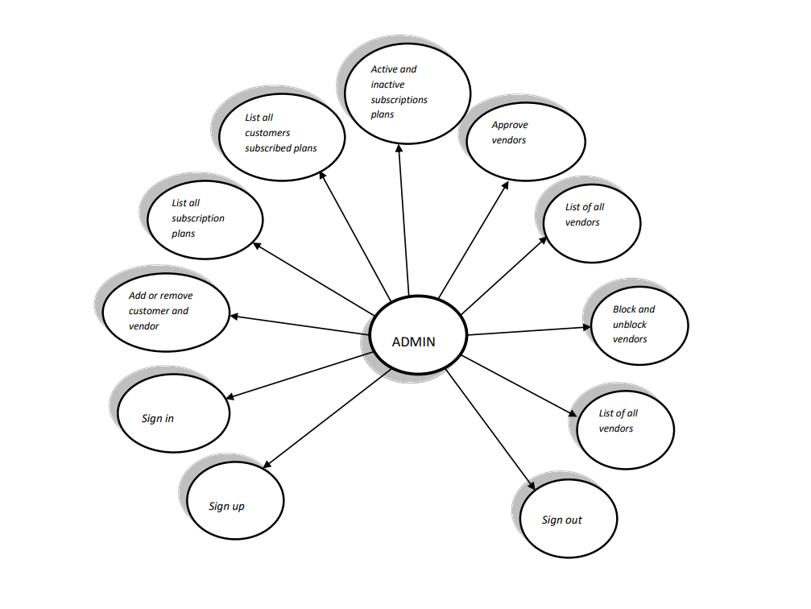
Admin use case diagram

Slide 7
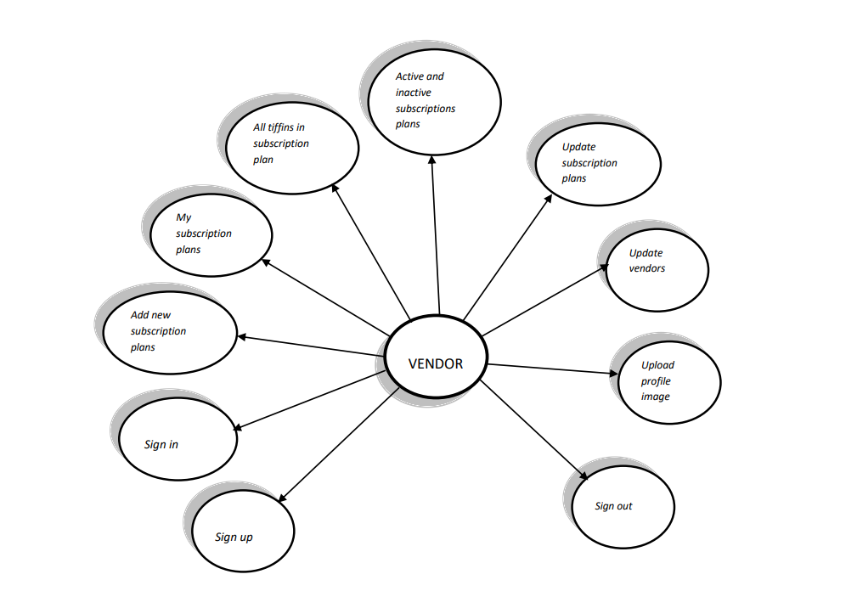
Vendor use case diagram

Slide 8
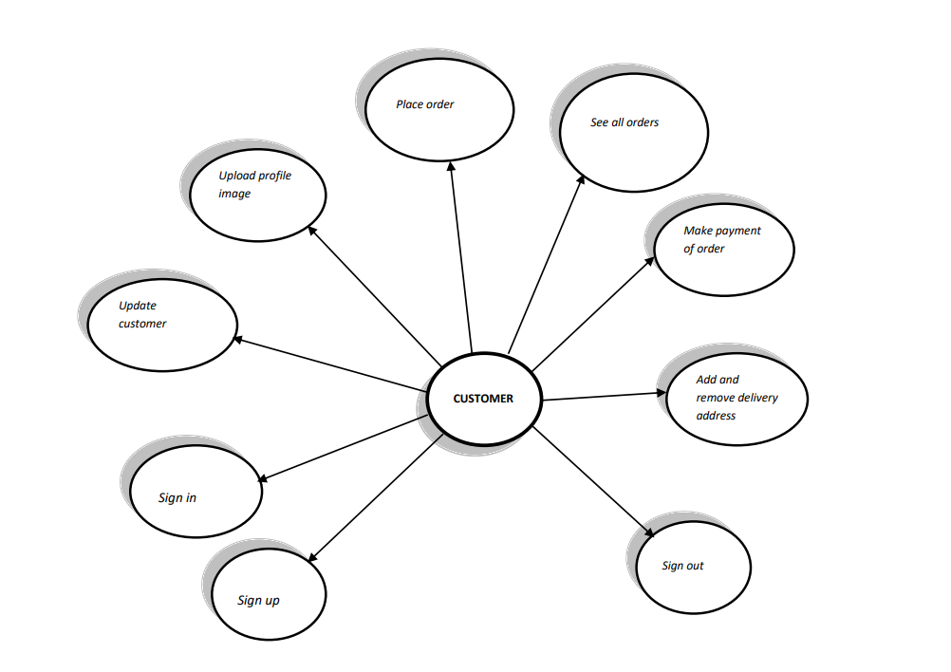
Customer use case diagram

Slide 9
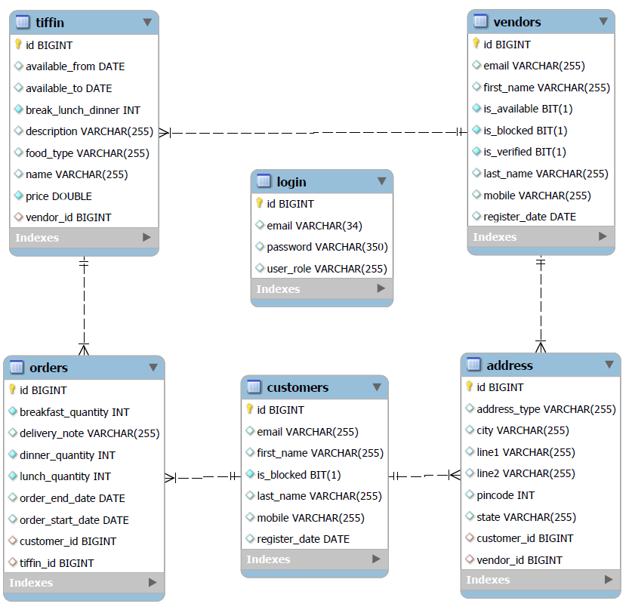
E-R Diagram(MySQL)

Slide 10
Future Scope
Payment Facility
OTP based verification
Forget Password

Slide 11
Thank you

